Slide 1
Derek Chen Intern Expo Software Engineer Intern –
NAME+TITLE
August 8, 2022

Slide 2
Agenda
Intern Innovation Challenge
Business Partner
Work
Takeaways
AT&T Loyalty Program
Point based reward system for utilization of AT&T services
App to track and spend rewards on merchandise and discounts
Utilizing Machine Learning Models to offer insight into fraud resolution call center efficiency
Optimize maximum calls answered without having abandoned calls
Used class knowledge to help implement real world supervised learning models
Used understanding from models to learn business insights for future applications

Slide 3
About Me
UC Santa Barbara Class of 2025, From West Hollywood, Los Angeles
Data Science (B.A.) Geography Minor
Interned at AT&T TDP LA (2023)
Before that interned at Makersplace (Ethereum blockchain startup)
- Hobbies: Hiking, Camping, Skiing, concerts, playing guitar, soccer, basketball
Play in band in Santa Barbara: The Colony (Joy Division, The Smiths, New Order)

Slide 4
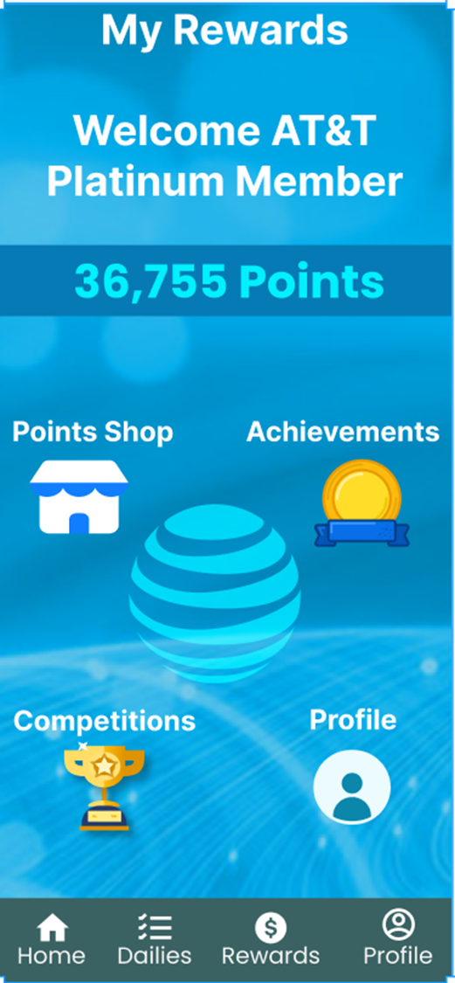
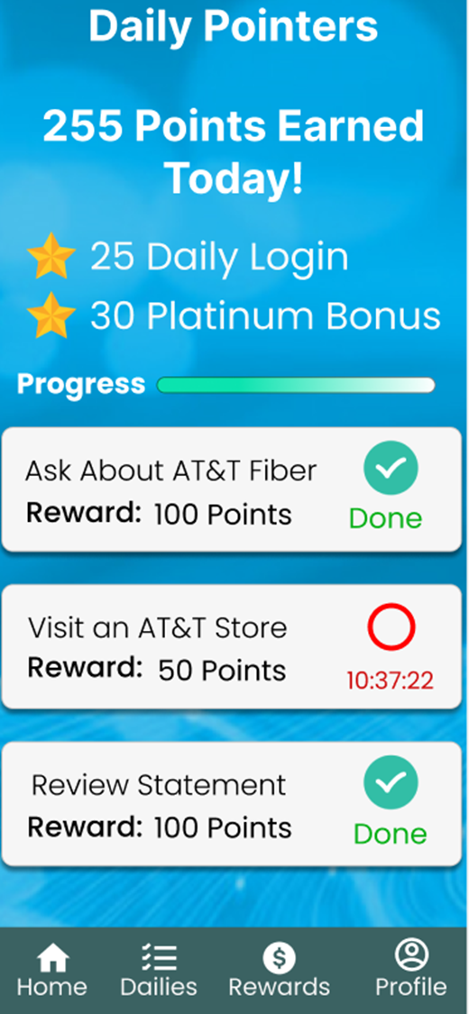
Intern Innovation Challenge
AT&T Loyalty Program
Rewards customers for spending on AT&T services, tagging AT&T on social media, and adding phone lines and internet
Point based reward system with physical merchandise redemption and discounts
Points given for timely interaction with the app and AT&T services

Slide 5
BP Work
CDO Fraud detection team using machine learning to flag and resolve potential fraud instances
Call center simulator class designed to use past data to simulate day to day running of the center
Trying to predict when call center will be over capacity and address it before it happens
Examine graphs and plots to look for patterns in data that can help more efficient operation

Slide 6
Extra Projects/Work/Activities

Slide 7
Key Takeaways

Slide 8
OUTRO + Thanks

